Slide 1

25 Facts about HKUST Undergraduates
CONFIDENTIAL. PLEASE DO NOT CITE WITHOUT AUTHOR’S PERMISSION
James Lee

Slide 2
Introduction
The following 25 facts about HKUST UG students are based on a database created by concatenating the yearly Survey on Background Information of Undergraduate Students conducted by the Student Affairs Office and official student records maintained by the HKUST Academic Records and Registration Office.
The database consists of individual records for 23 freshmen cohorts from 1991 to 2013 (excluding mainland and international students) and includes over 45,000 undergraduate students. To protect individual privacy we have removed all identifying information, such as name and university student ID for confidentiality.

Slide 3
Enrollment

Slide 4
Fact 1: Three Periods of Growth in UST History
freshmen enrollment more than tripled in the first four years from about 600 in 1991 to almost 2000 in 1994
After 1994, freshmen enrollment plateaued at around 2000 per year
Since 2009, freshmen enrollment gradually increased from 2000 in 2009 to 2500 in 2015. Moreover due to the 3-3-4 double cohort, the 2012 class was well over 4000

Slide 6
Fact 2: Most UST students are from the schools of Science, Engineering, and Business and Management
Engineering students account for about 40 percent of UG graduates
Business and Management students have gradually decreased and now account for 30 percent of UG graduates
Science students have gradually increased and now also account for 30 percent of UG graduates

Slide 8
Gender

Slide 9
Fact 3: UST female freshmen account for almost 40 percent compared to 60 percent at other UGC universities
In the School of Science, while the proportion of female freshmen has declined from 46 percent in 1998 to below 30 percent in 2010, it has rebounded since to 37 percent
In the School of Engineering, female freshmen have doubled from about 10 to over 20 percent
In the School of Business and Management, female freshmen have declined from 66 percent in 2003 to 50 percent today

Slide 11
Fact 4: The proportion of female UG graduates has declined from 44 percent in 2001 to 36 percent in 2013
This decline is driven by a sharp decline in female graduates in the School of Science from 47 percent in 2001 to 30 percent in 2013 and in the School of Business and Management from almost 70 percent in 2003 to below 60 percent in 2013
In contrast, in the School of Engineering, female graduates have increased from10 percent in 1995 to 23 percent in 2013

Slide 13
Fact 5: The proportion of female graduates is lowest in Engineering and highest in Business
As in the United States, the STEM major with the greatest proportion of females is biology
Unlike the United States, many females also graduate in Mathematics
The lowest proportions of UG female graduates are in EE, CE, and ME
The highest proportions of female graduates are in finance, accounting, and marketing where they account for almost 80 percent
Notes:
Econ?

Slide 15
Fact 6: The largest number of female graduates are in marketing and accounting
The largest number of female UG graduates are from marketing, accounting, and finance followed by two science majors: biology and math
Applied physics, logistics management (LM) and physics, which have so far graduated less than 200 females, are the smallest majors in terms of female UG graduates
No engineering major has more then 500 female UG graduates

Slide 17
Fact 7: The share of female graduates in math has declined precipitously since 2001
The proportion of female math graduates declined from a peak of almost 60 percent in 2001 to less than 20 percent in 2012
Female graduates have also declined for chemistry, business/economics, and physics
In engineering, however, females graduates have steadily increased

Slide 19
Family Background

Slide 20
Fact 8: Increasing proportions of freshmen come from white collar versus blue collar families
The share of freshmen from production worker family background has declined from over 30 percent in the early 1990s to slightly over 20 percent in 2007
The proportion of freshmen with professional or managerial fathers has increased over the same period from below 10 to over 15 percent

Slide 22
Fact 9: More females than males come from professional, managerial, and business families
Female freshmen are more likely than their male counterparts to have professional or managerial fathers
Female freshmen are also less likely to come from blue-collar families, especially for the period from 2002 to 2007

Slide 24
Fact 10: Business graduates are more likely to have fathers with administrative, professional, and business careers
While about 20 percent of graduates with Bachelor’s degrees in science or engineering come from professional, managerial, and business families, the percentage of business graduates from such families, at least from 2002 onwards, has been about 30

Slide 25
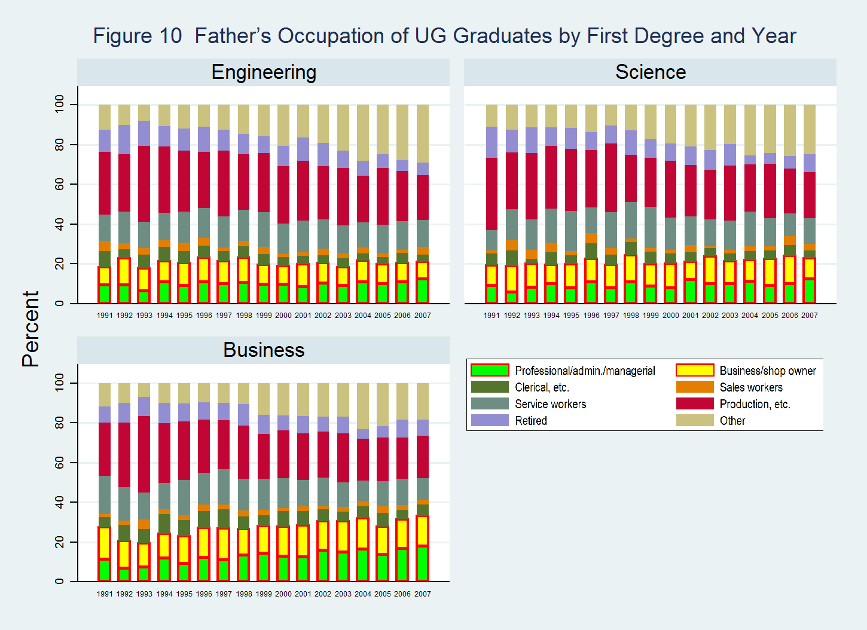

Slide 26
Fact 11: The percentage of freshmen fathers with secondary or higher education has risen from 50 to 75
The proportion of freshmen with fathers with only primary or no education has dropped from over 50 percent in 1991 to about 25 percent in 2012
The proportion of students with fathers with secondary education has increased to over 50 percent
The proportion of students from post-secondary educated family background has increased from below 15 percent in 2000 to 25 percent in 2012

Slide 28
Fact 12: Female students are more likely than males to be born to fathers with postsecondary education
Female freshmen are generally less likely than their male counterparts to have fathers with primary or less education
Such female advantage in father’s education has become increasingly salient in the last ten years

Slide 30
Fact 13: Business graduates are more likely to come from post-secondary educated families
Business students are more likely than science and engineering students to come from families with a college-educated father
The proportion of students with father with primary or less education has declined faster for business students than engineering and science students
While science students are recently more likely than engineering students to come from educated families, overall these groups are homogeneous in terms of father’s education

Slide 31
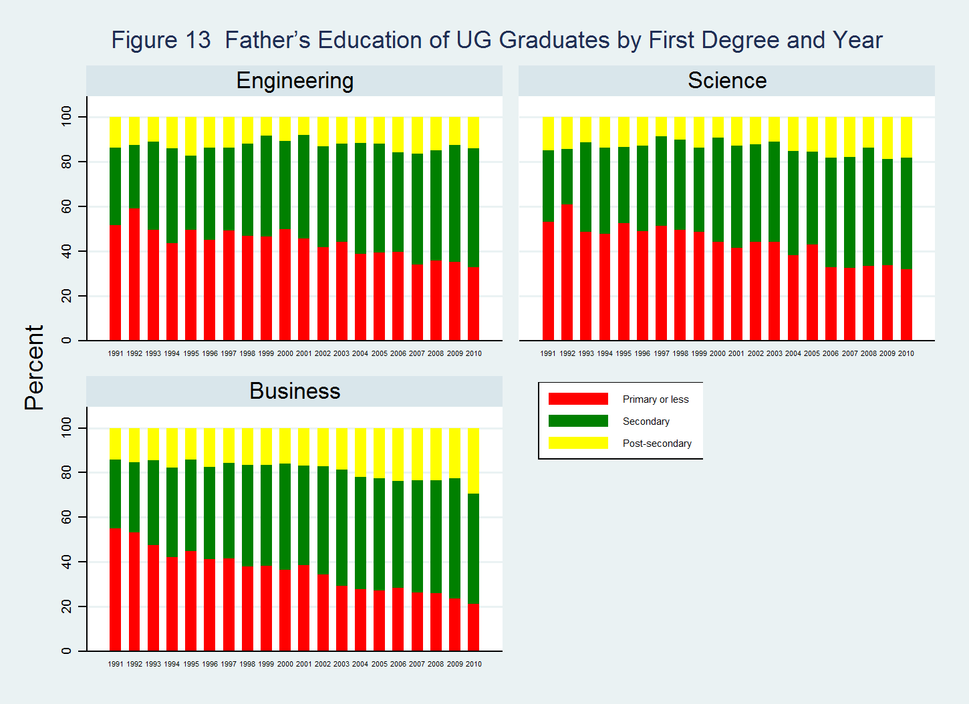

Slide 32
Fact 14: Families of freshmen students have become wealthier over time
The proportion of students from families at the bottom of the income distribution has declined
While the proportion of students from top income families (HK$50,000 or above) did not increase significantly during the period 2000-2007, the share of students from families with total family income of HK$40,000 or above has significantly increased since 2009

Slide 34
Fact 15: Female freshmen are more likely than males to come from high-income families
Overall, female students are better off than male students with respect to family income
The sex disparity in family income has widened in recent years

Slide 36
Fact 16: Business graduates are more likely than science and engineering graduates to come from high income families
Overall, more business students come from high income families than science and engineering students
Science and engineering students are similar with respect to share of students with low levels of family income
While more engineering students than science students came from high income families in early years, the pattern is the opposite for recent years

Slide 37
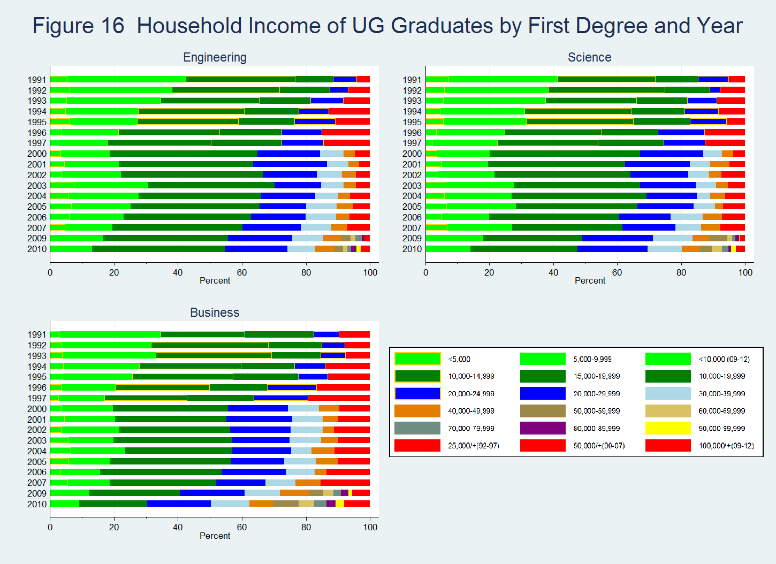

Slide 38
Fact 17: Proportion of UST students living in public rental housing resembles the general population
Like the general population in Hong Kong, the share of UG students from families living in public rental housing units has been declining
About one third of the 2012 freshmen come from families living in HA or HS rental housing units
Conversely, the proportion of students living in family owned private flats has increased from 40 percent in 2000 to 50 percent today

Slide 40
Fact 18: Female freshmen are more likely than male freshmen to live in family owned housing
Female freshmen are less likely than male freshmen to live in public rental housing units
Due to a sharp increase in private flat ownership for female student families, this disparity in family housing conditions has become more salient in recent years

Slide 42
Fact 19: Business UG graduates are less likely than science and engineering graduates to live in public rental housing
Business student families as opposed to science and engineering student families are more likely to own their home rather than rent
The gap in family home ownership between business students and their science and engineering counterparts has become salient in recent years

Slide 43
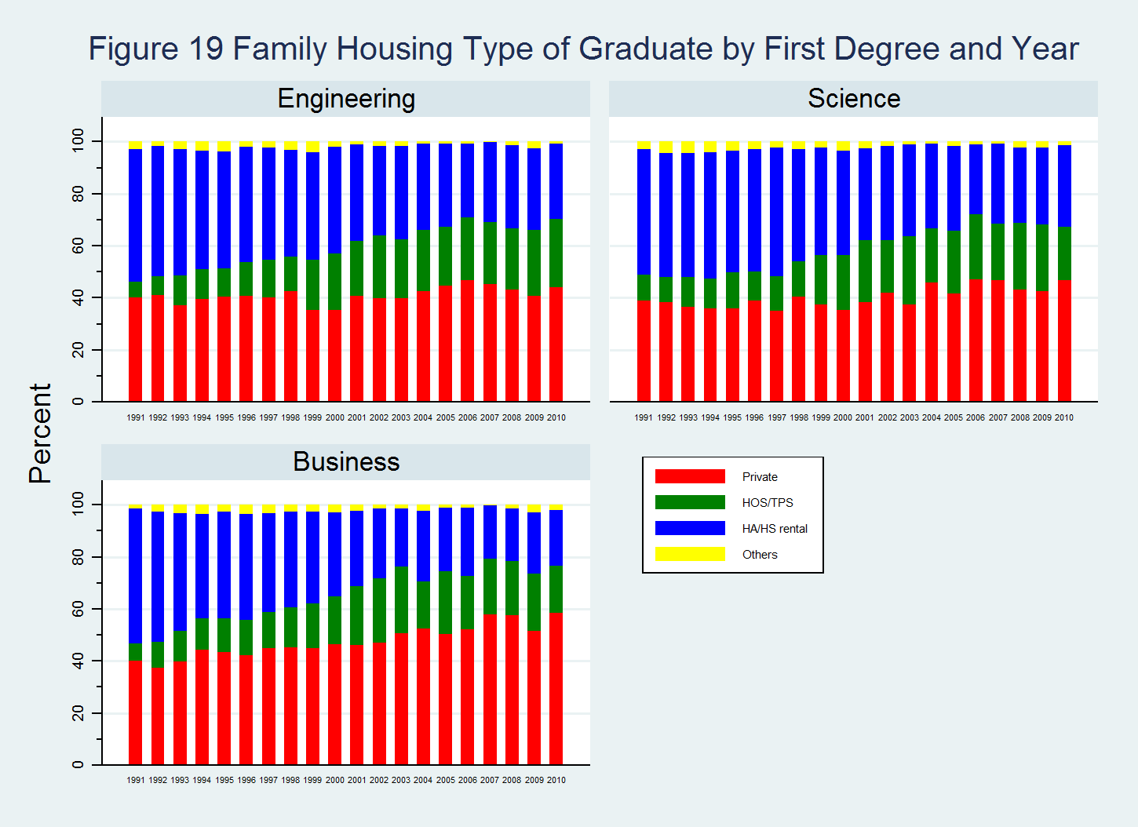

Slide 44
Fact 20: Proportion of freshmen from homes with less than 40 m² has declined from 60 to 30 percent
The proportion of freshmen from families with no more than 40 square meters of living area has declined from about 60 percent in 1992 to 30 percent in 2007
The share of freshmen from families with 80 or more square meters of living area has increased, but these students only account for 10-15 percent of the 2007 freshmen cohort

Slide 46
Fact 21: About 90 Percent of UG Students Live within Two Hours’ Commute
Over the years, the vast majority of freshmen have come from areas within 2 hours’ commute to UST
For recent cohorts, about 30 percent of freshmen live in areas within one hour’s commute to UST

Slide 48
Previous Schooling

Slide 49
Fact 22: The majority of UST feeder schools supply limited numbers of students to UST
Since 1991, only 35 schools have sent more than 200 students to UST
Many of these top feeder schools are among the best in Hong Kong
Over 60 percent of all UST feeder schools have sent no more than 50 students to UST in all from 1991-2015

Slide 51
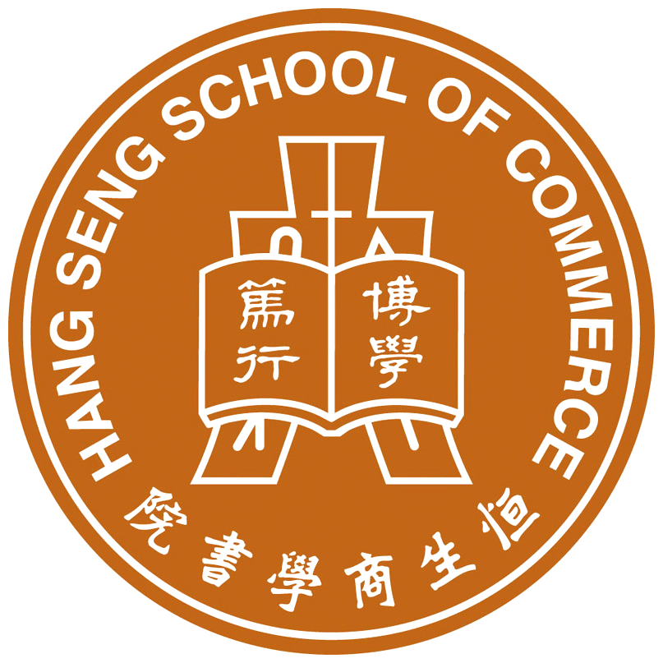









Table 1 Top 10 UST Feeder Schools
 | High School | UST Admission | %DSE 5/+ | %JUPAS 3322 | %College
 | Hang Seng School of Commerce | 921 | 74.8^{[1]}
 | Po Leung Kuk Vicwood K. T. Chong Sixth Form College, KTC | 688 | 57* | 38.6
 | La Salle College | 325 | 43
 | SKH Tsang Shiu Tim Secondary School | 297 | 39.6 |  | 79.1
 | King's College | 283 |  | 81.3
 | St Paul's Co-Educational College | 277 | 66 | 91.9 | 99
 | St Paul's Convent School | 277 |  |  | 100
 | Queen's College | 270 | 66 | 85.5 | 62^{[2]}
 | Kwun Tong Maryknoll College | 268 | 22 |  | 90
 | St Joseph's College | 267 | 21.1 | 87.97 | 85
Note: [1] Percent 1 A in 2012 HKALE instead. [2] Percentage of students enrolled in UGC funded degree programs. Students attending college oversea are excluded.

Slide 52
Fact 23: Three quarters of UST feeder schools are classified as caput schools
Three quarters of UST feeder schools are classified as caput schools, non-profit-making private secondary schools that receive governmental subsidy by selling some of their slots for students
Direct Subsidy Scheme (DSS) schools account for about one tenth of all UST feeder schools
English Schools Foundation (ESF) schools account for only slightly over one percent of UST feeder schools

Slide 54
Fact 24: UST feeders schools are evenly distributed with respect to banding
UST feeder schools are evenly distributed with respect to banding
One-third of UST feeder schools belong to the elite Band 1 (1A/1B/1C)
One-third of UST feeder schools belong to Band 3 (3A/3B/3C) and 4 schools

Slide 56
Fact 25: Most UST feeder schools are located in less affluent districts
Most UST feeder schools are in Kowloon and New Territories
Eastern stands out as the only Hong Kong Island district that has a large number of UST feeder schools
Most UST feeder schools are located in less affluent districts – Sha Tin, Tuen Mun, Yuen Long, and Eastern (Island) – some of which, Tuen Mun and Yuen Long, are quite distant

Slide 58


